Slide 1





Grid Fruit

Slide 2




Funding Sources

Slide 3


Deployment Partners
Grid Fruit

Slide 4


Slide 5


Slide 6







Slide 7







Slide 8


Slide 9


Slide 10


Slide 11


Slide 12


Slide 13



Slide 14


Slide 16



Slide 18





Slide 19


Slide 20


Slide 21


Slide 22


Slide 23



Slide 24




Slide 25




Slide 26










Slide 27
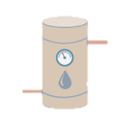







Slide 30
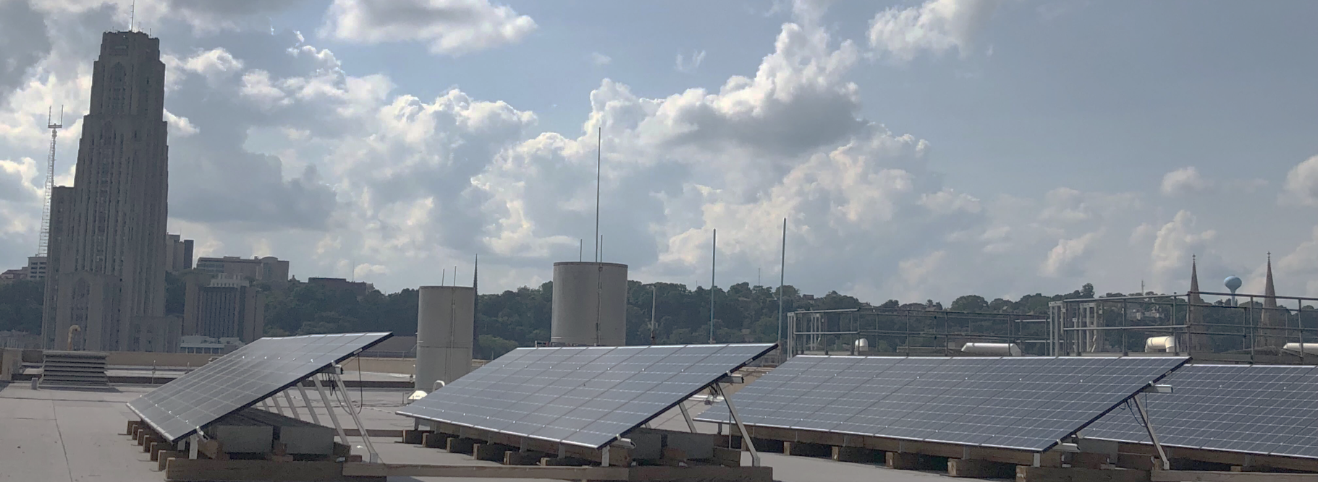

Slide 31


Slide 32


